Slide 1
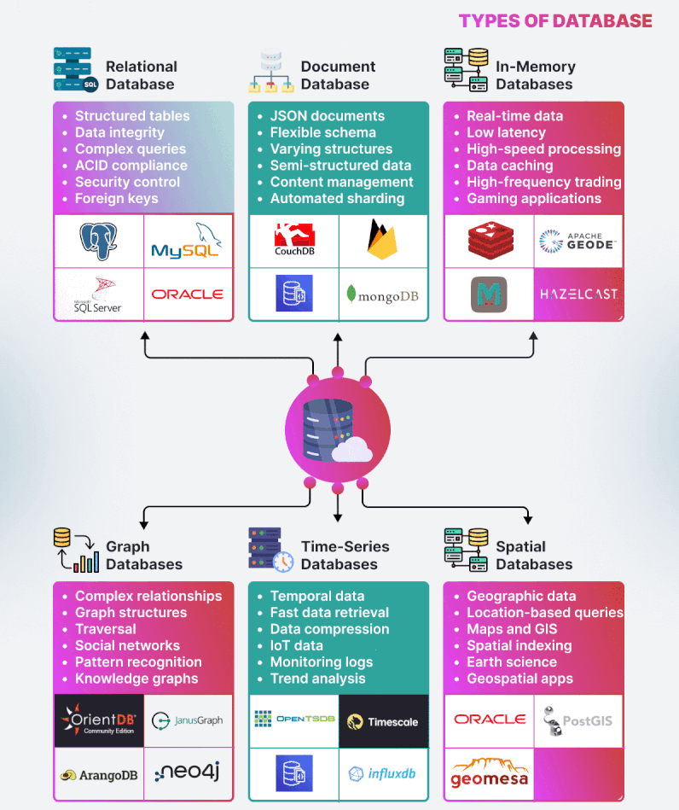

Slide 2
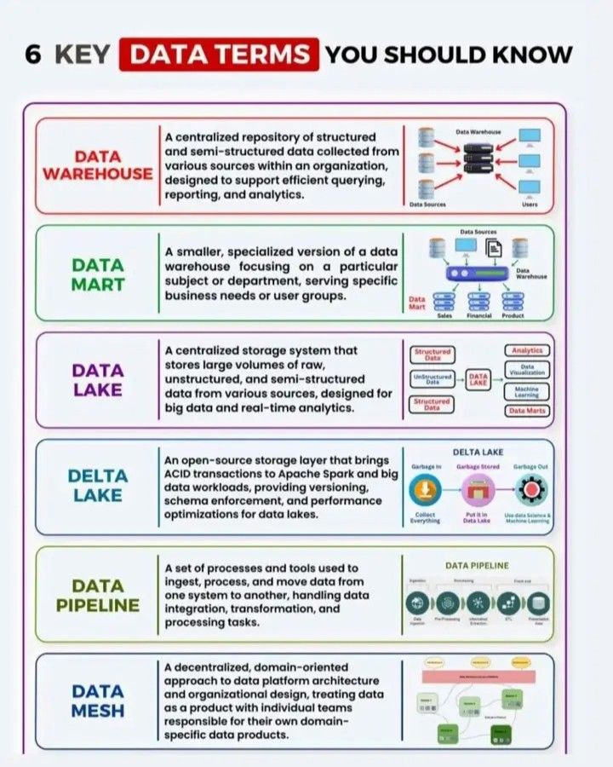

Slide 3
Differences between Import, DirectQuery, and Live Connection modes in Power BI:
Import Mode:
- Data Handling:Data is imported and stored in Power BI's memory.
- Performance: Fast, as data is preloaded.
- Use Cases: Best for small to medium datasets; supports complex calculations.
- Limitations:Requires scheduled refreshes; limited by dataset size.
DirectQuery Mode:
- Data Handling:Data remains in the source; queries run in real-time.
- Performance: Depends on the data source's speed.
- Use Cases: Suitable for large datasets and real-time analysis.
- Limitations: Limited DAX functions; slower if the source isn't optimized.
Live Connection:
- Data Handling: Direct connection to SSAS models or Power BI datasets.
- Performance: Depends on the SSAS model or dataset.
- Use Cases: Ideal for using centralized, pre-built models.
- Limitations: No data modeling or custom measures in Power BI.
Note: Choose Import for performance, DirectQuery for real-time data, and Live Connection for using existing centralized models.

Slide 4
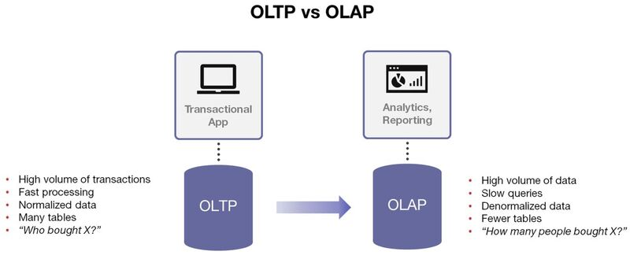

Slide 5
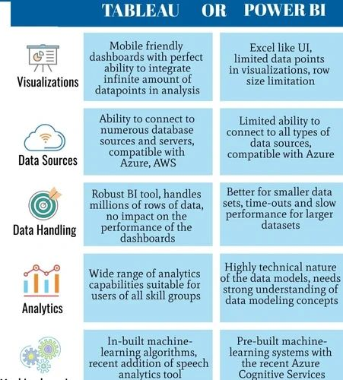

Slide 6
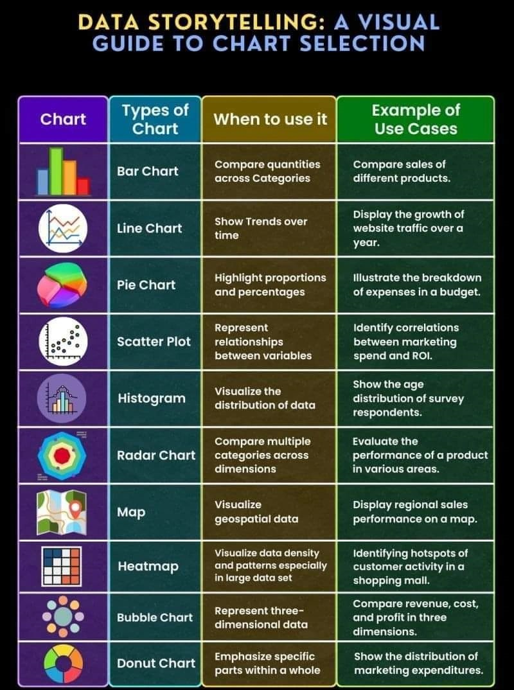

Slide 7
